Slide 1
Languages and Compiler Design II
Strongly Connected Components
Herbert G. Mayer
PSU Spring 2010
rev.: 5/28/2010
PSU
CS322
HM <number>

Slide 2
Agenda
SCC Definition
Tarjan’s Algorithm
3-Node Sample
Modified Algorithms
4-Node Sample
Sample Graph
References
PSU
CS322
HM <number>

Slide 3
SCC Definition
Given a directed graph G = { V, E }, with a set of vertices V, and connecting edges E
A strongly connected component SCC is a subgraph of G such that any vertex in SCC can reach every vertex in SCC
  Not necessarily in 1 step
By definition then, a singleton node is an SCC, yet for the detection of loops this is not of interest
  A singleton node with a back edge to itself is of interest
An SCC does not require a single entry point, a single exit point, or a single back-edge
PSU
CS322
HM <number>

Slide 4
Tarjan’s Algorithm
Given graph G = ( V, E )
num = 0 // unique node number > 0
stack = null // ptr to node stack
SCC = 0 // number of SCCs in G
// cfg nodes have following fields:
// num: a unique number to ID node
// lowlink: ties node to others in SCC
// pred: ptr to stack predecessor
// instack: true if node is in stack
forall nodes v in V do
if v.num = 0 then // yet unvisited
find_scc( v )
end if
end forall
push( v ) // stack may be null
v.pred = stack
v.instack = true
stack = v
end push
pop( v ) // val param v is stack copy
stack = v.pred
v.pred = null
v.instack = false
end pop
find_scc( v )
v.num = v.lowlink = ++num
push( v )
forall nodes w in succ( v ) do
if w.num = 0 then // not yet visited
find_scc( w )
v.lowlink = min( v.lowlink, w.lowlink )
elsif w.instack then
v.lowlink = min( v.lowlink, w.num )
end if
end forall
if v.lowlink = v.num then // v: head of SCC
SCC++ // track how many SCCs found
print( “SCC %d holds:”, SCC )
repeat
x = pop( stack )
print( x.num, “, “ )
until x = v
end if
end find_scc
PSU
CS322
HM <number>

Slide 5
3-Node Sample
1
Num:
Low:
Stack:
2
Num:
Low:
Stack:
3
Num:
Low:
Stack:
PSU
CS322
HM <number>

Slide 6
3-Node Sample, Cont’d
Outside call to find_scc( for node 1 )
  Increments num to 1, sets fields .num and .lowlink = 1
  Pushes node 1, i.e., stack = 1, node 1’s predecessor = null
  Recursive call to find_scc( for node 2 )
  When done, find that lowlink = num, hence SCC
Recursive call find_scc( node 2 )
  Set node 2’s .num and .lowlink = 2
  Stack points to node 2, node 2.pred is node 1
  Has 2 successors: node 1 and node 3
  But node 1 is visited, while node 3 causes new find_scc( node 3 )
Recursive call find_scc( node 3 )
  Set .num and .lowlink = 3
  Stack points to node 3, node 3.pred is node 2
  Has no successor
  But lowlink = num hence is SCC, but is a singleton-node SCC
PSU
CS322
HM <number>

Slide 7
Modified Algorithm
When a node v’s lowlink = number, then v is head of an SCC
All nodes x are popped of the stack, until node x = v
If this happens at the first pop, then Tarjan’s method identifies a singleton node
Check beforehand and detect singleton SCCs
PSU
CS322
HM <number>

Slide 8
Modified Algorithm, Cont’d
Given graph G = ( V, E )
num = 0 // unique node number > 0
stack = null // ptr to node stack
SCC = 0 // number of SCCs in G
// cfg nodes have following fields:
// num: a unique number to ID node
// lowlink: ties node to others in SCC
// pred: ptr to stack predecessor
// instack: true if node is in stack
forall nodes v in V do
if v.num = 0 then // yet unvisited
find_scc( v )
end if
end forall
push( v ) // stack may be null
v.pred = stack
v.instack = true
stack = v
end push
pop( v ) // val param v is stack copy
stack = v.pred
v.pred = null
v.instack = false
end pop
find_scc( v )
v.num = v.lowlink = ++num
push( v )
forall nodes w in succ( v ) do
if w.num = 0 then // not yet visited
find_scc( w )
v.lowlink = min( v.lowlink, w.lowlink )
elsif w.instack then
v.lowlink = min( v.lowlink, w.num )
end if
end forall
if v.lowlink = v.num then // v: head of SCC
if v = stack then // singleton SCC
x = pop( stack )
else
SCC++ // track how many SCCs found
print( “SCC %d holds:”, SCC )
repeat
x = pop( stack )
print( x.num, “, “ )
until x = v
end if
end if
end find_scc
PSU
CS322
HM <number>

Slide 9
4-Node Sample
1
Num:
Low:
Stack:
2
Num:
Low:
Stack:
3
Num:
Low:
Stack:
4
Num:
Low:
Stack:
PSU
CS322
HM <number>

Slide 10
4-Node Sample, Cont’d
Outside call to find_scc( node 1 )
  Increments global num to 1, sets fields v.num and v.lowlink = num = 1
  Pushes node 1, i.e., stack = 1, and first node v.pred = null, but v.instrack - true
  Calls find_scc( with node 2 )
  When done, find that lowlink = num = 1, hence SCC, but is top of stack node, so do not record as singleton SCC
Recursive call from 1 to find_scc( node 2 )
  Set .num and .lowlink = 2
  Stack points to node 2, node 2.pred is pointer to node 1
  Has 2 successors: node 3 and node 4, both with num = 0
  When back from 3 and 4, lowlink stays 2 since is min() already
Recursive call from 2 find_scc( node 3 )
  Set .num and .lowlink = 3
  Stack points to node 3, Recursive call find_scc( node 2 )
  Node 2 has lowlink = 2, hence 3’s lowlink set to 2
Recursive call from 2 find_scc( node 4 )
  Set .num and .lowlink = 4
  Stack points to node 4
  No successor node
  Is singleton SCC, but not recorded
  return to recursive call for node 2
PSU
CS322
HM <number>

Slide 11
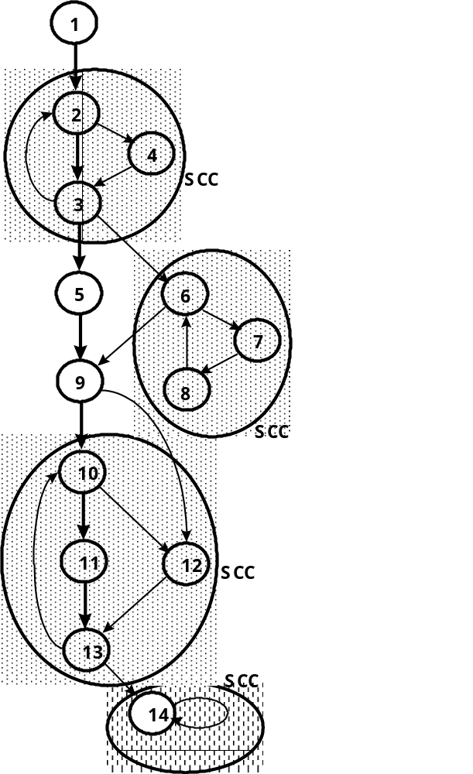
Sample Graph
PSU
CS322
HM <number>

Slide 12
References
Robert E. Tarjan, Depth-first search and linear graph algorithms, SIAM Journal on Computing, Volume 1, Number 2, pages 146-160, 1972
Alfred V. Aho et al., Compilers Principles, Techniques, and Tools, Addison-Wesley Publishing Co., ©1986 or newer, ISBN 0-201-10088-6
PSU
CS322
HM <number>

